Slide 1

E-commerce:
Brazilian (Olist) Orders Dataset
Bernard Bernabeo
King Eluard Camota
Patrick Salazar
Trizzia Ellaine Singson

Slide 2
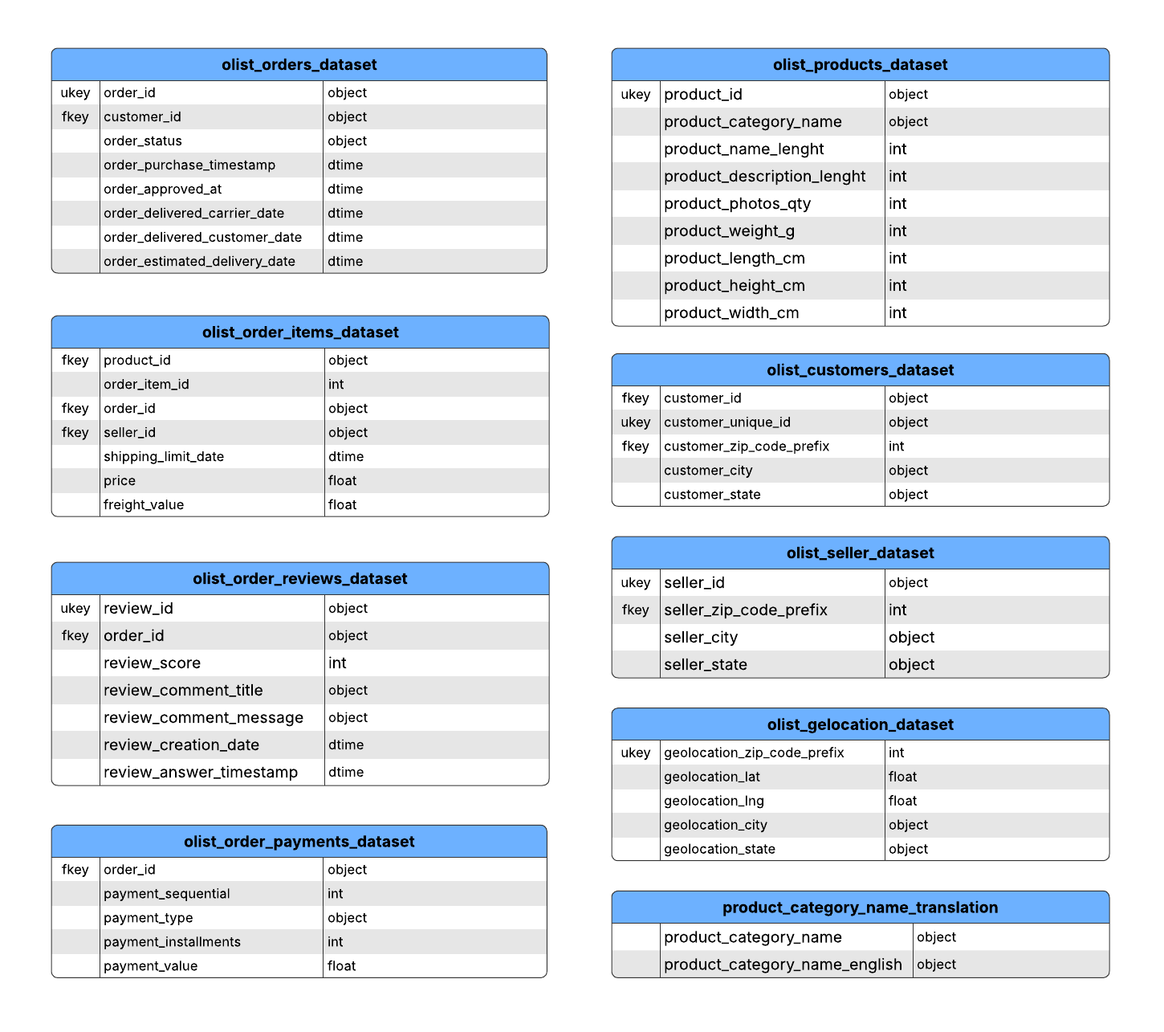
Brazilian E-Commerce Dataset by Olist
This unstructured dataset focuses on the Brazilian E-Commerce Public Dataset by Olist, from Kaggle, which provides information about approximately 100k+ orders placed from 2016 to 2018.
It is made to provide various aspects of the customer purchasing experience, from order placement to fulfillment and post-delivery reviews.

Slide 3
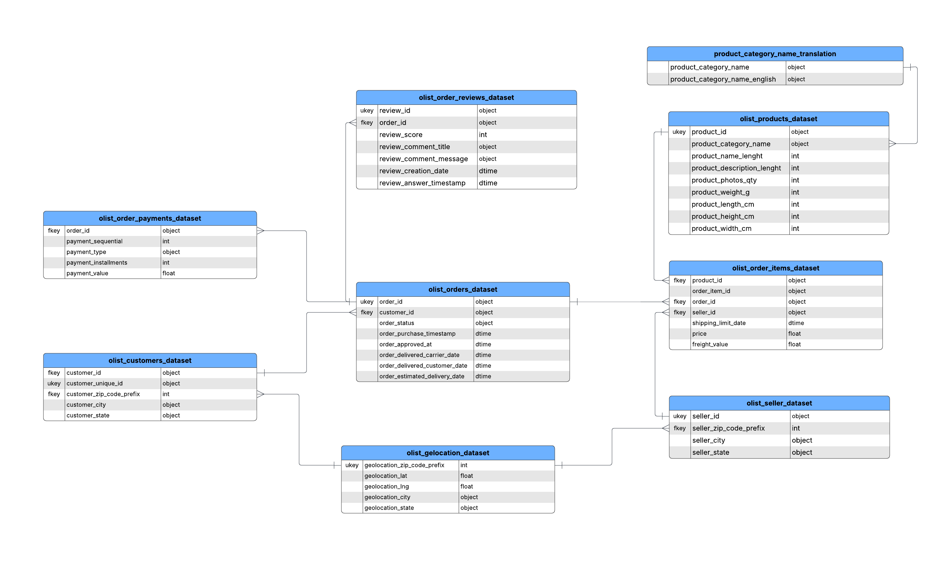
Entity Relationship Diagram
Reason | Explanation
Simplicity | You can do analysis without worrying about joins across 5–6 tables
Less Engineering Overhead | No need to design surrogate keys, indexes, or maintain data integrity rules
Faster for Small-to-Mid Joins | In smaller datasets, table joins aren’t performance bottlenecks anyway
Easier to Prototype | Perfect for quick EDA (Exploratory Data Analysis), dashboards, and quick metrics
ETL-Free | You can load and clean data once in a flat table—no transformation pipelines yet
Great for Pandas / Power BI | These tools are optimized for working with wide tables in-memory

Slide 4
Objectives
Identify customer distribution and sales performance by location
Analyze performance of products by categories and revenue
How Have Sales and Orders Changed Over Time?
Develop a model that predicts a more robust estimation of delivery date

Slide 5
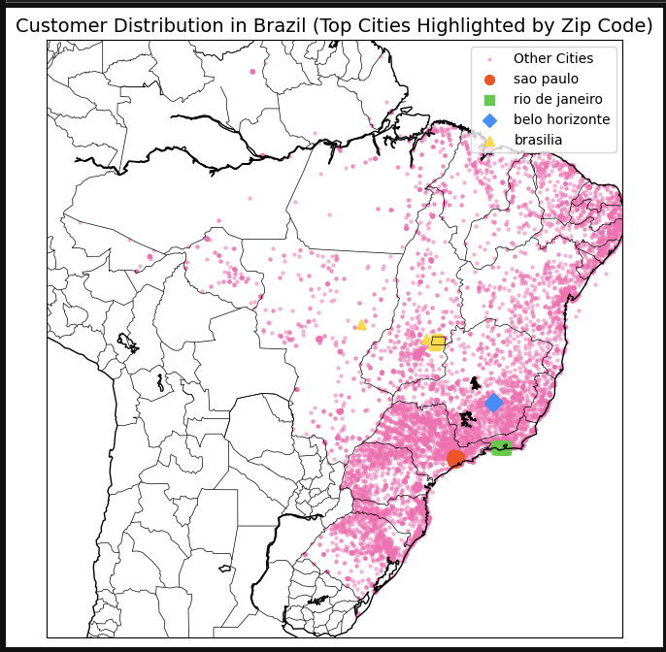
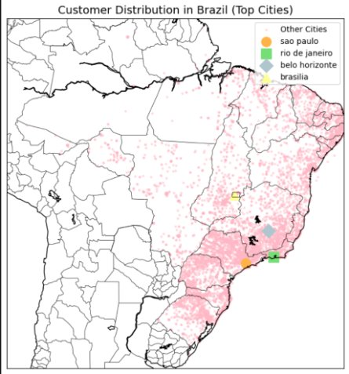
Objective 1: Identify customer distribution and sales performance by location
Scattered Zip Codes
Lack of Data Grouping
Outlier Points Included
Inconsistent Representation
Customer Distribution
Notes:
Here, we compare two different visualizations of customer distribution:
The left map shows scattered zip codes where data points are directly plotted based on customer locations. This resulted in scattered visuals, especially for cities like Brasilia where hundreds of zip codes were spread out.
The right map shows cleaned data where zip codes were grouped by prefix, and a central point was calculated for each city.
Grouping by zip_code_prefix effectively averaged customer locations, reducing noise and merging duplicated points.
This provided a clearer representation of customer distribution and allowed us to compare cities more accurately.

Slide 6
Objective 1: Identify customer distribution and sales performance by location
Inconsistency | Solution (How It Was Fixed)
Scattered Zip Codes: | Grouping by zip_code_prefix: Averaged customer locations by zip codes, reducing noise and merging duplicated points.
- Cities like brasilia had hundreds of zip codes scattered over a wide area. | - Grouping points by zip codes provided a cleaner visualization.
Lack of Data Grouping: | Central Point Calculation: Averaged all zip code entries per city to produce a single reliable location.
- Multiple zip codes per city caused overlapping points. | - Creating a central point eliminated scattered points, especially for brasilia.
Outlier Points Included: | Outlier Handling: Averaging entries reduced the impact of irrelevant or incorrect points.
- Incorrect or miscategorized zip codes contributed to cluttered visuals. | - Averaging provided a consistent, accurate representation of each city.
Inconsistent Representation: | Uniform Representation: Using central points ensured fair comparison between cities.
Customer Distribution
Notes:
By grouping data by zip_code_prefix and averaging the latitude and longitude values, outlier points that previously caused cluttered visuals are effectively removed.
This method ensures that each city is accurately represented by a single, reliable central point.
Averaging entries from multiple zip_code_prefix entries per city minimizes the impact of irrelevant or incorrect points, providing a cleaner and more accurate visualization. This approach allows for a reliable comparison of customer distribution and sales performance, particularly for cities with numerous zip codes like brasilia.

Slide 7
Objective 1: Identify customer distribution and sales performance by location
Cleaning (How Outliers Were Handled):
Cleaning Step | What We Did | Why This Was Necessary
Group by zip_code_prefix | Averaged customer points per zip_code_prefix. | Reduced noise and clutter from raw data points.
Calculate Central Points | Consolidated entries to a single point per city. | Improved consistency and accuracy of city representation.
Visual Clarity Enhancement | Used pastel colors for better visibility. | Made comparison of top cities easier and more effective.
Notes:
📌 Tables for Schema (Files Used):
olist_customers_dataset.csv: Provided customer information, including zip_code_prefix linked to geographical locations.
olist_geolocation_dataset.csv: Contained geographical details like latitude, longitude, city, and state associated with each zip_code_prefix.
olist_order_payments_dataset.csv: Contained payment_value needed for analyzing sales performance.

Slide 8
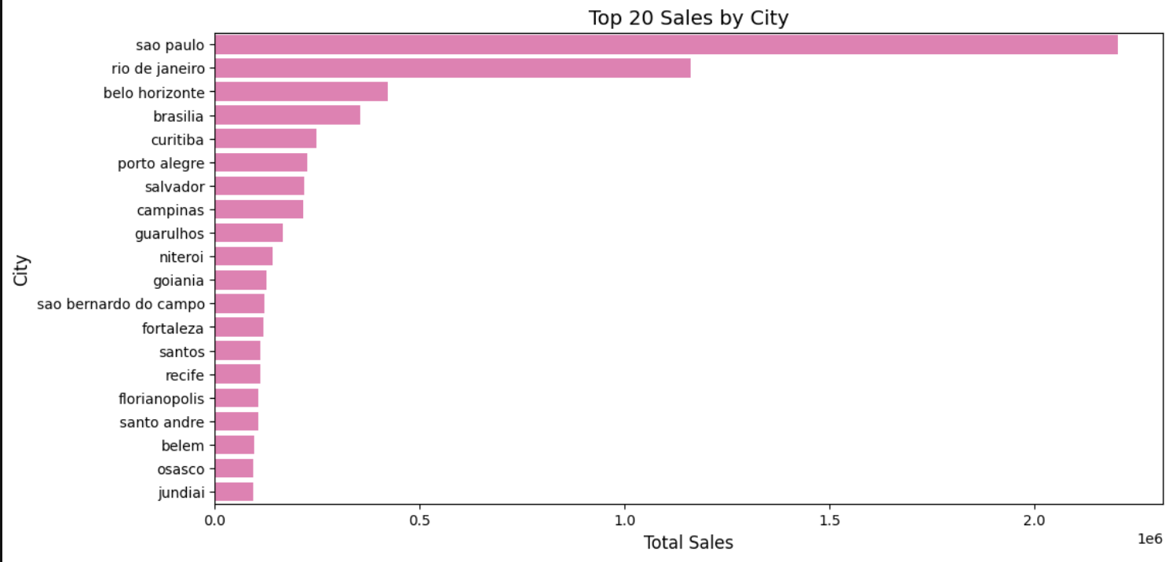
Objective 1: Identify customer distribution and sales performance by location
Handling Missing Values:
Dropped rows with missing entries in critical columns (geolocation_lat, geolocation_lng, geolocation_zip_code_prefix, customer_id, payment_value).
Data Transformation:
Merged datasets (olist_customers, olist_orders, olist_order_payments) to prepare sales_by_location DataFrame.
Aggregated sales data per city to provide a reliable summary.
Outlier Handling:
Removed cities with unusually low sales values (payment_value < 1000) - threshold set.
Sales Performance
Notes:
We identified which cities contribute the most to the overall sales performance."
This slide shows the sales performance by city using a bar chart.
We aggregated sales data per city to provide a reliable summary.
The bar chart displays the top 20 cities by total sales. The most prominent sales from Sao Paulo followed by Rio de Janeiro.
The use of central points and removing outliers greatly improved our analysis.

Slide 9



Olist Product Category Performance Analysis

Slide 10
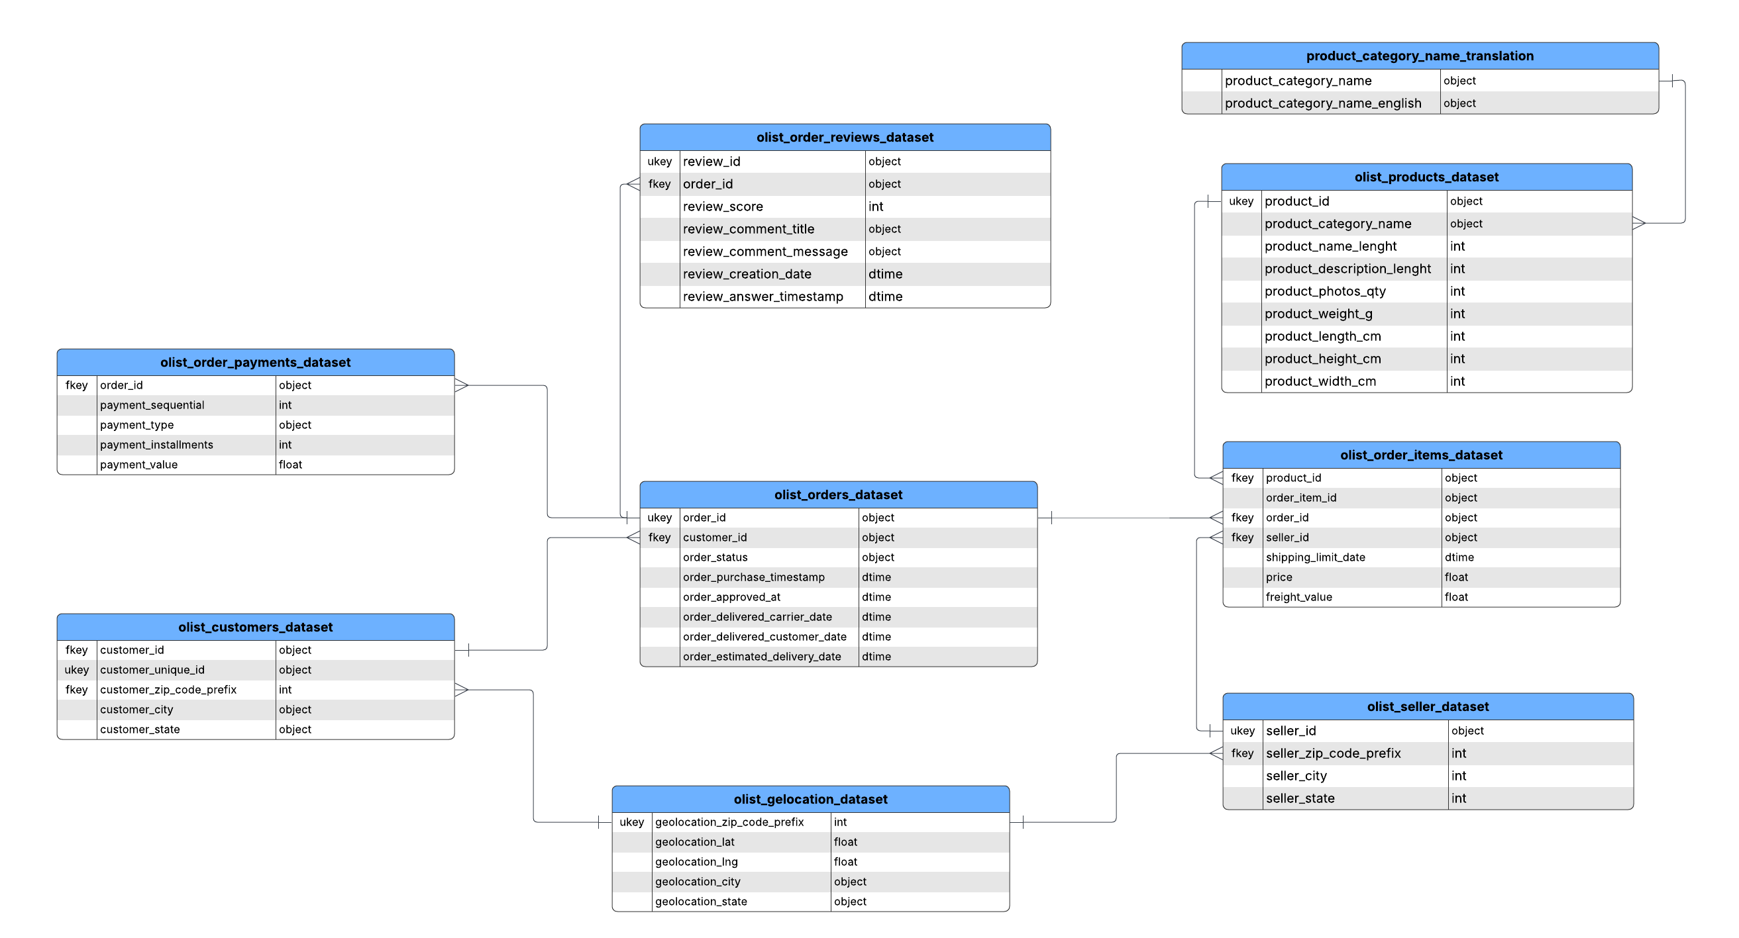
Objective 2: Product Category Performance Analysis
Data Transformation
3NF (Normalized Schema) → OBT (One Big Table)
Notes:
Third Normal Form (3NF) — each table serves a single purpose (e.g., products, reviews, orders) and avoids redundancy.

Slide 11
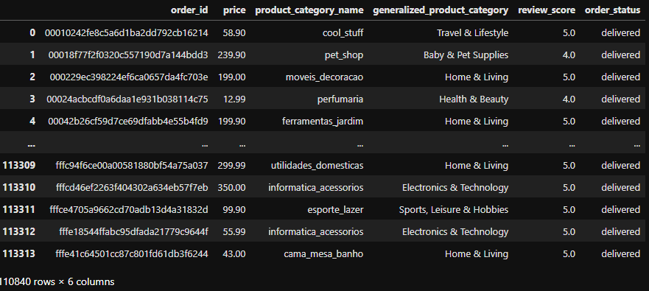
Objective 2: Product Category Performance Analysis
Data Transformation
Notes:
Third Normal Form (3NF) — each table serves a single purpose (e.g., products, reviews, orders) and avoids redundancy.

Slide 12
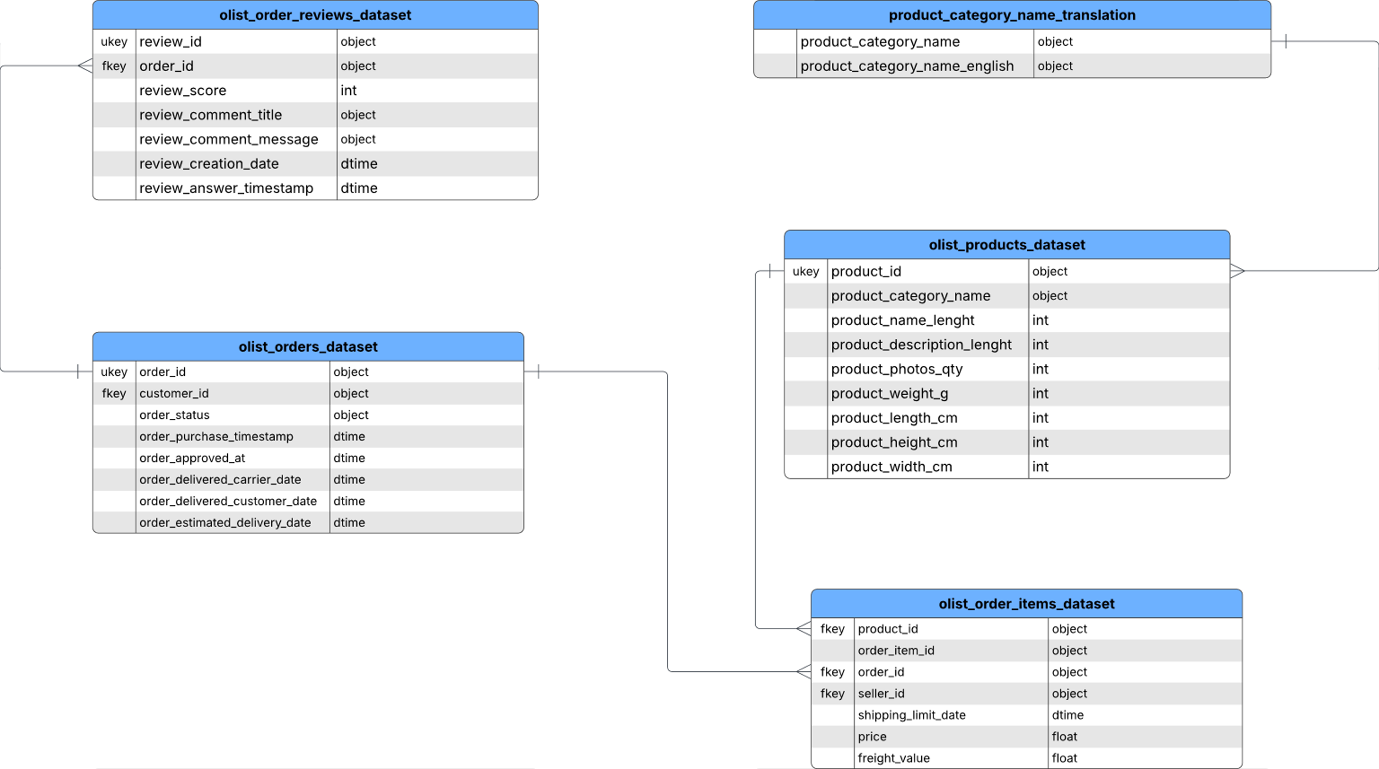
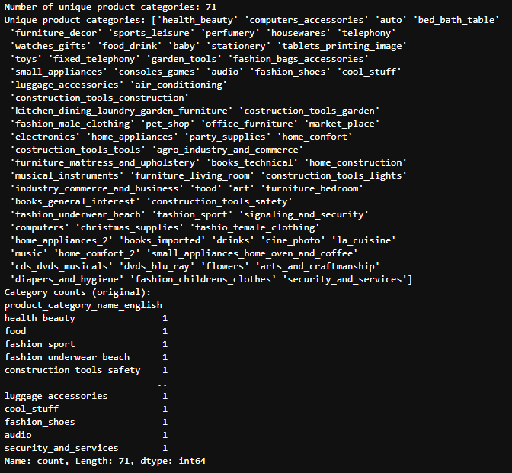
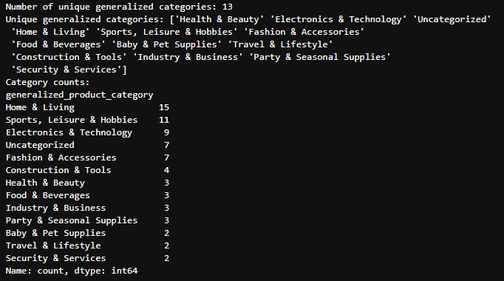
Product Category Performance Analysis
Data Transformation
Generalizing product categories
Generalized Product Categories
Product Categories (from Original dataset)
Notes:
Third Normal Form (3NF) — each table serves a single purpose (e.g., products, reviews, orders) and avoids redundancy.

Slide 13
Product Category Performance Analysis
Data Cleaning
Cleaning Step | What We Did | Justification
Filter data | Only select "delivered" orders in `order_status` column | Only purchases with “delivered” status were considered as successful transaction
Dropping Null Values | Drop null values on columns `review_score`and ‘generalized_product_category | Null value means no product rating from the customer. Keeping null values will affect the review score for a specific product. Untraceable product category.
Tables for Schema
olist_orders_dataset.csv
olist_order_reviews_dataset.csv
olist_order_items_dataset.csv
olist_products_dataset.csv
product_category_name_translation.csv
Transformation: Categorize product category: reduce 71 to 12
Product category translation to English
Formatting:
Converted revenue to currency string for display
Rounded review scores to 2 decimal places
Formatted order counts with commas
Cleaning:
Filtered out orders with order_status != 'delivered’
Removed rows with missing category translations (via inner merge or dropna)
Basic Feature Engineering:
Created total_revenue per category by summing price of delivered items
Counted number of order lines per category as order_count
Calculated average review_score per product category
Created broad_category feature by mapping product categories to grouped themes
Notes:
Nan: 1567 (generalized product category) and 827(review rating)

Slide 14
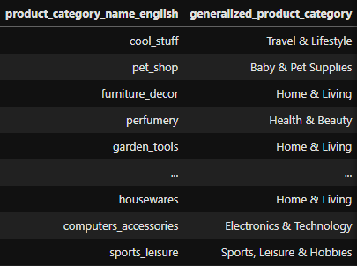
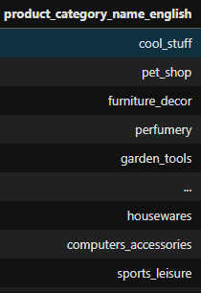
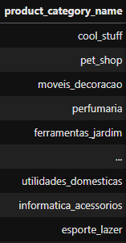
Product Category Performance Analysis
Feature Engineering
Before Feature Engineering
After Feature Engineering
Notes:
Third Normal Form (3NF) — each table serves a single purpose (e.g., products, reviews, orders) and avoids redundancy.

Slide 15
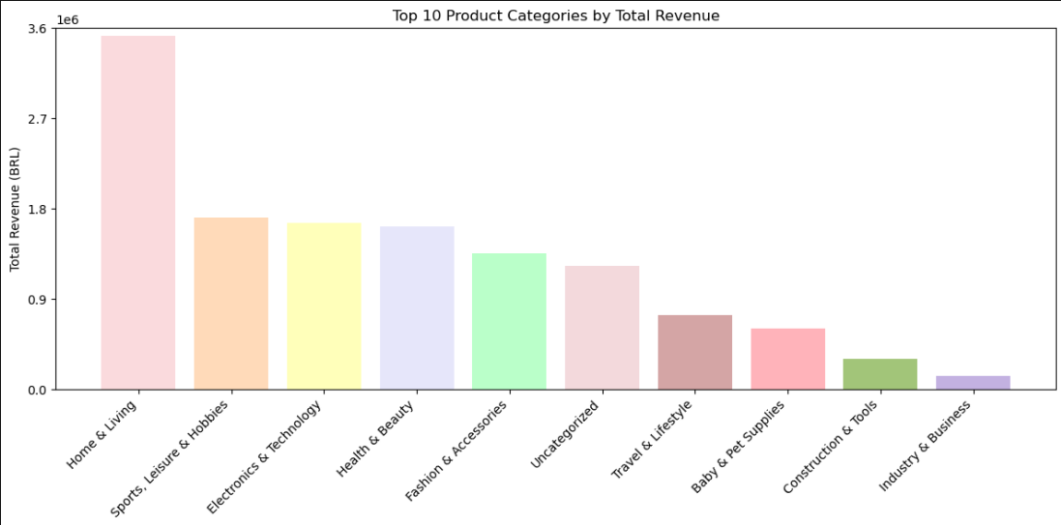
Product Category Performance Analysis

Slide 16
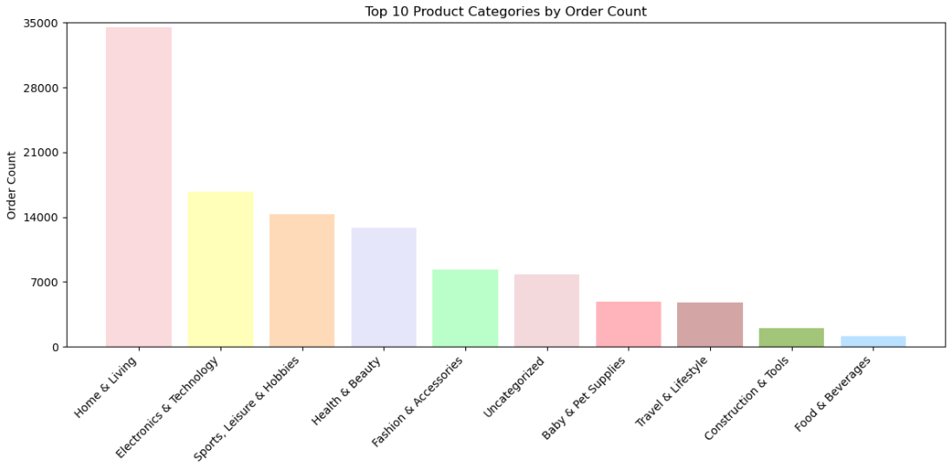
Product Category Performance Analysis

Slide 17
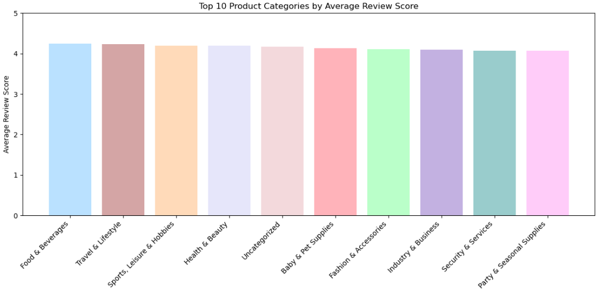
Product Category Performance Analysis

Slide 18

How Have Sales and Orders Changed Over Time?

Slide 19
Objective 3: How Have Sales and Orders Changed Over Time?
3NF (Normalized Schema) → OBT (One Big Table)

Slide 20

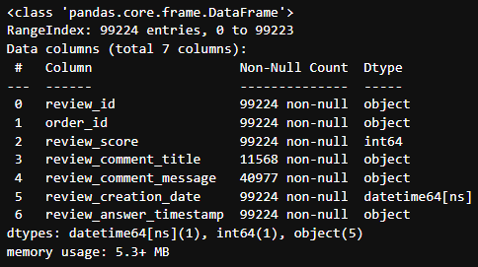
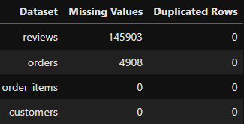
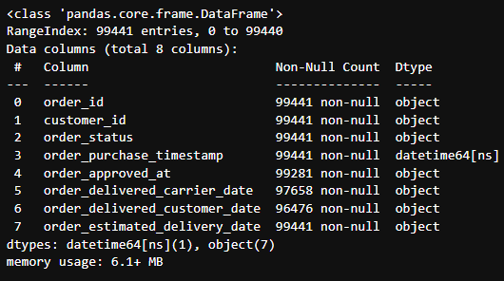
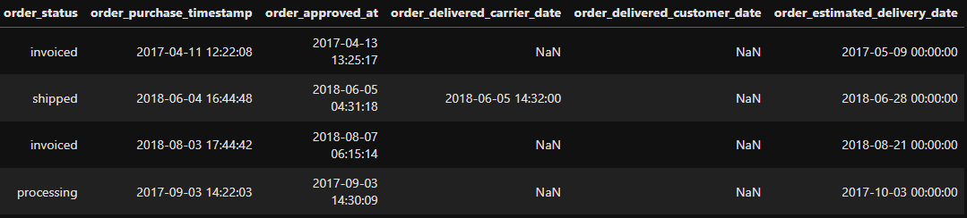
Data Cleaning
Objective 3: How Have Sales and Orders Changed Over Time?

Slide 21
Data Cleaning

Slide 22
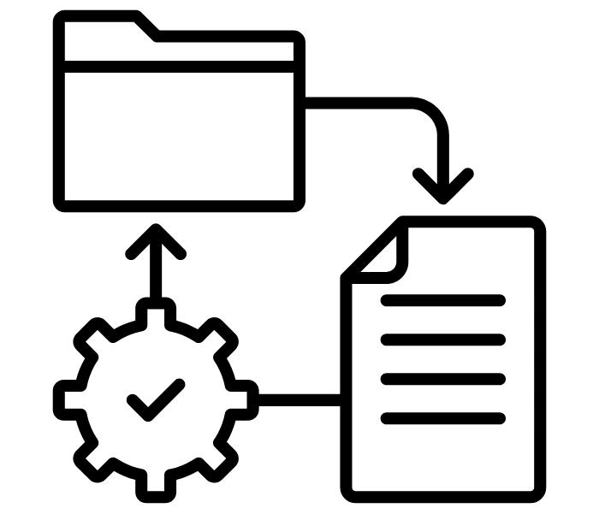

Data Transformations
Objective 3: How Have Sales and Orders Changed Over Time?

Slide 23
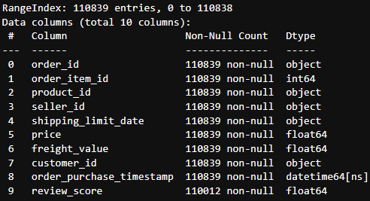
Data Transformations
Objective 3: How Have Sales and Orders Changed Over Time?
Transformation | What We Did | Why This Was Necessary
Create new column | Quarter/Year | To fit 2016 to 2018 monthly trend into a readable line chart without losing too much insight/s.
Create a subset | Group by Quarter | To get the summation of Price per quarter giving us the total sales.
Transform Datatype | Object to datetime | To get a sequential trend line from 2016 to 2018.
Cleaning | What We Did | Why This Was Necessary
Drop Null Values | Drop “review_score” null values | To reduce noise and ensure charts reflect real score trend and not missing data dips.
Notes:
Only scored orders are meaningful — NaN would skew averages
Dropping NaN ensures your charts reflect real score trends, not “missing data dips”.

Slide 24

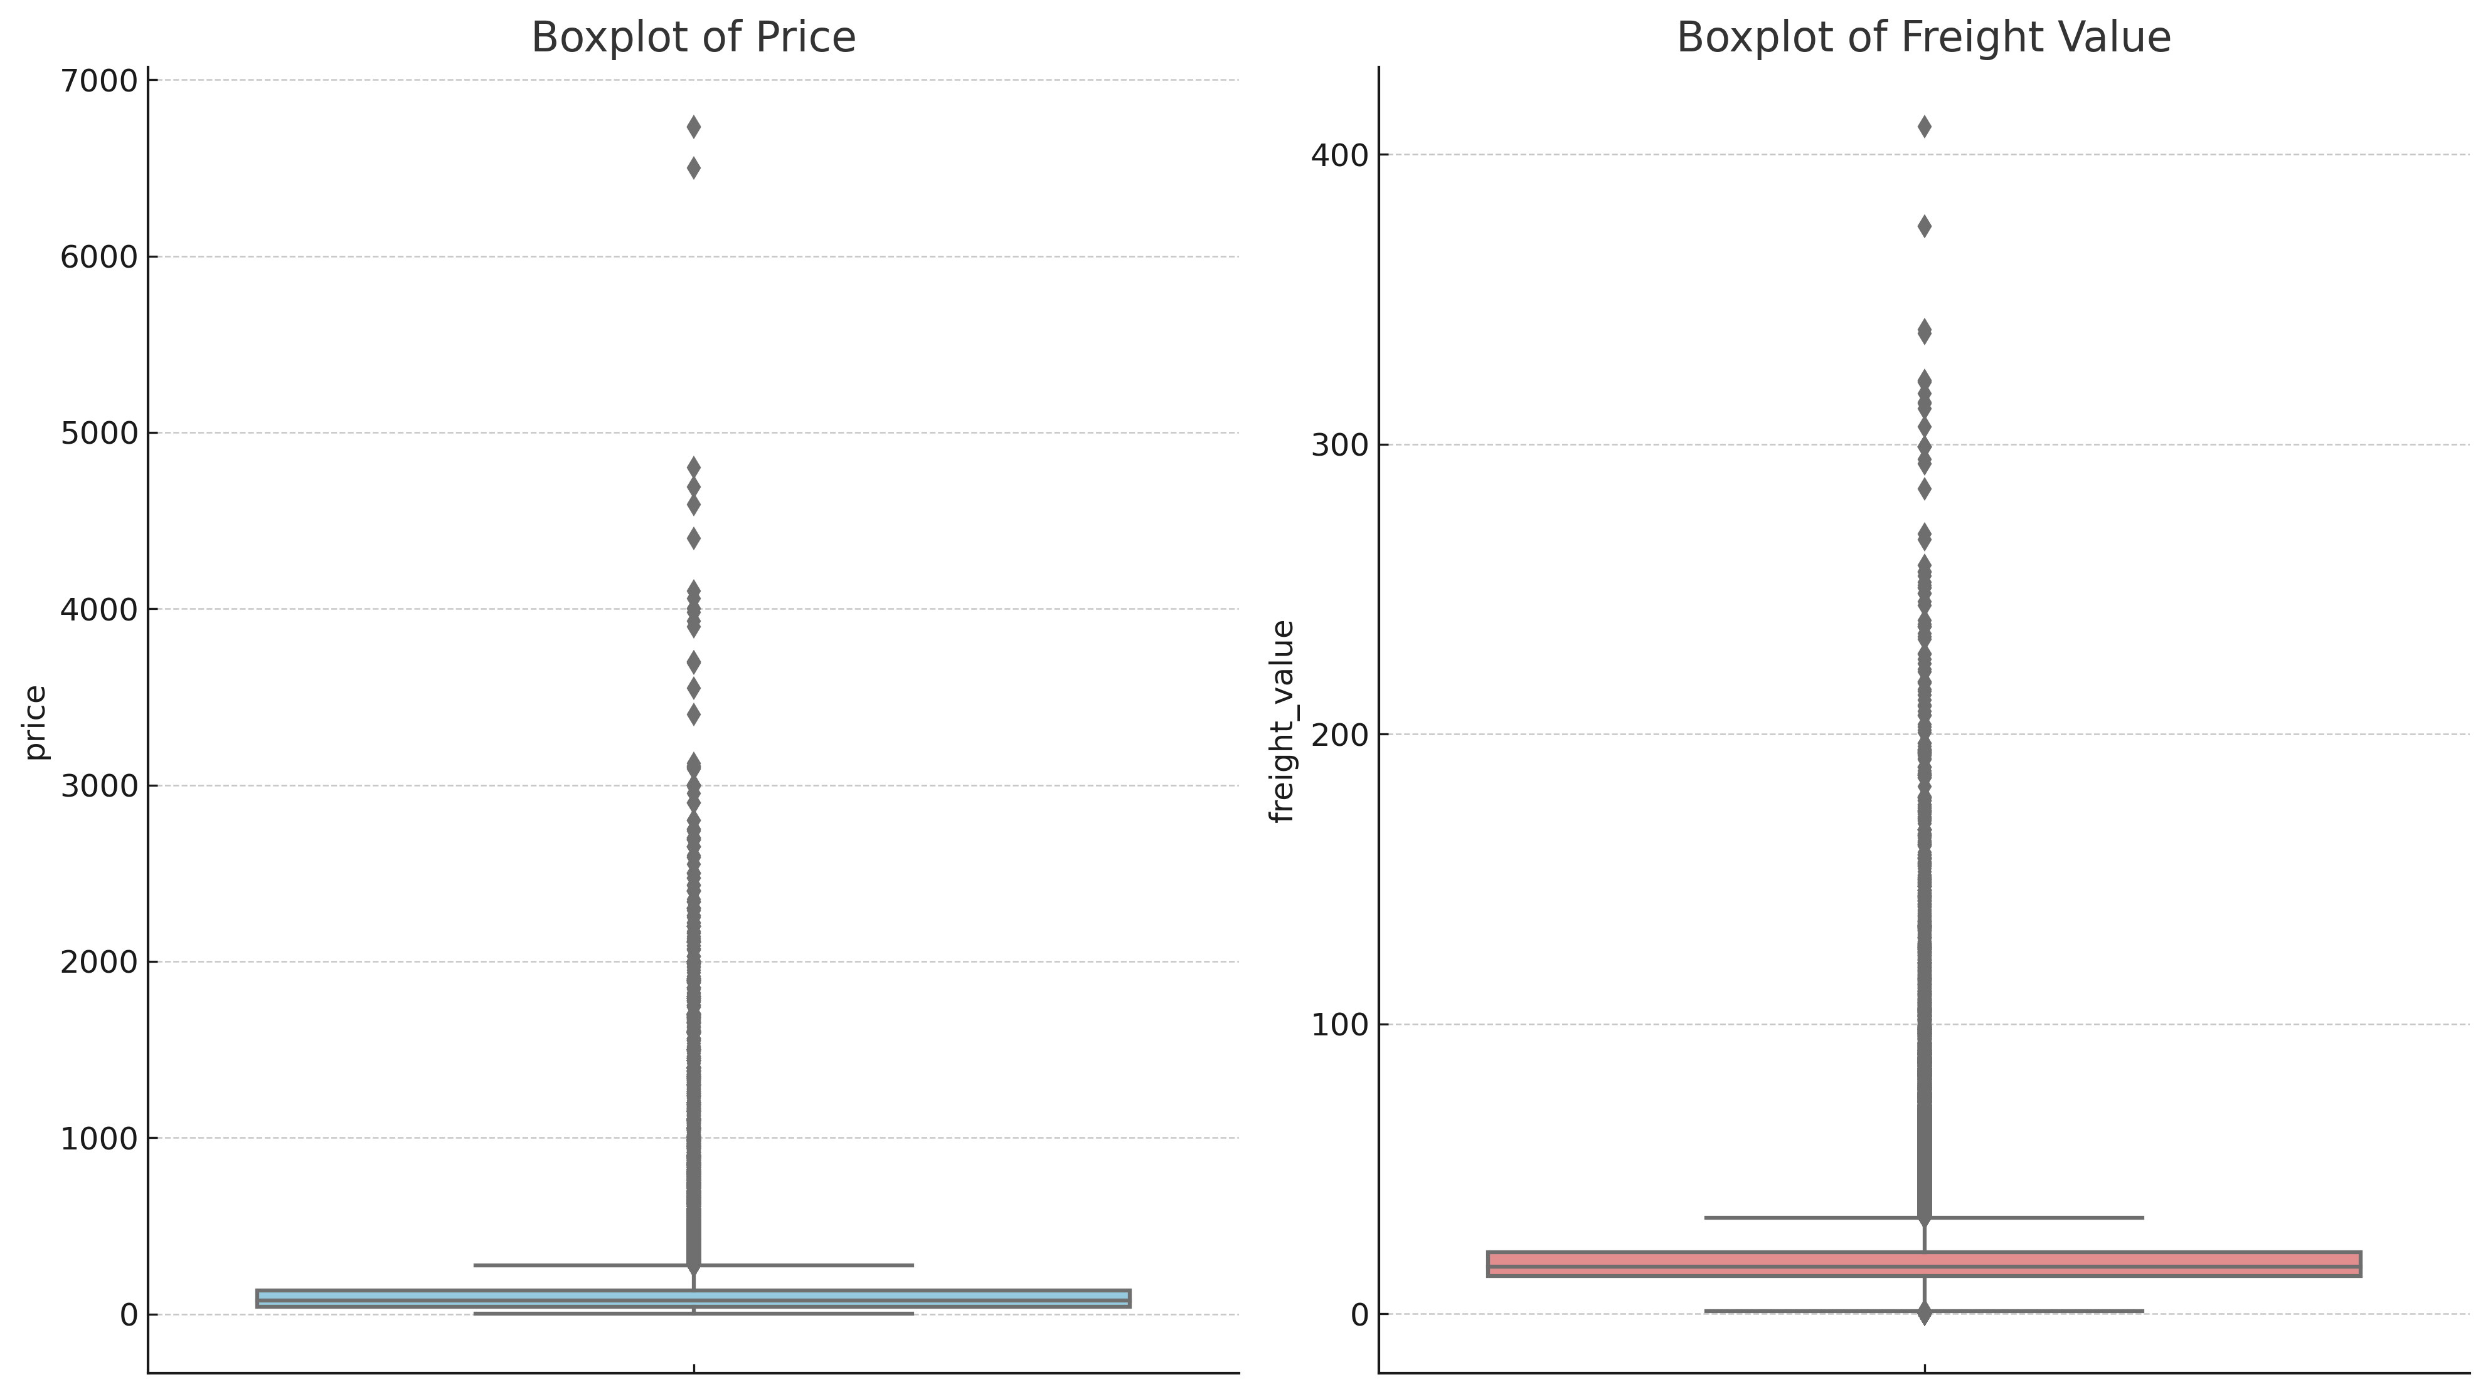
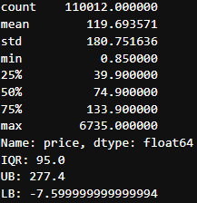
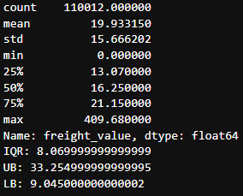
Data Integrity & Outlier/s Handling
Objective 3: How Have Sales and Orders Changed Over Time?

Slide 25
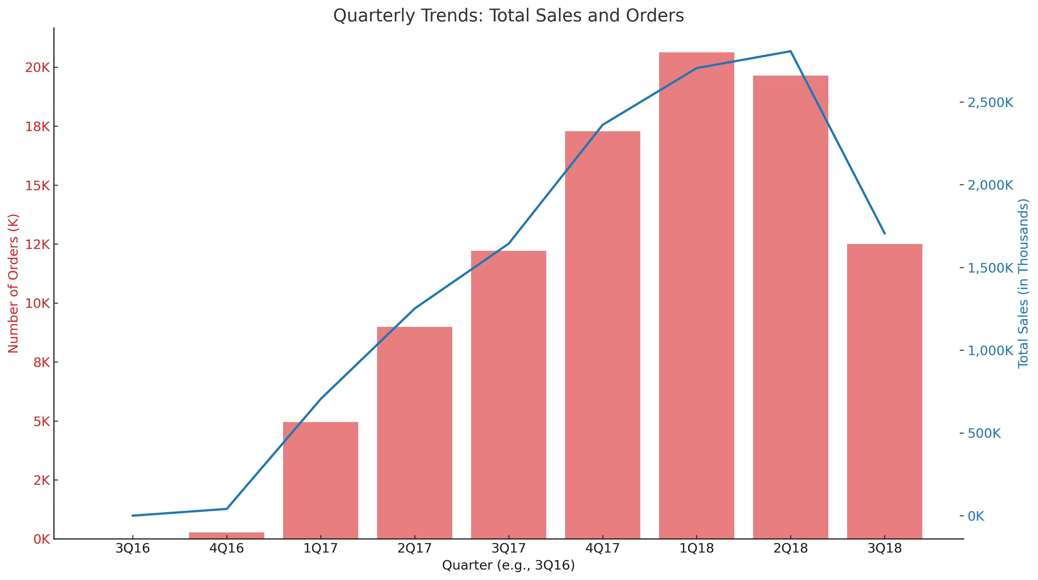
Objective 3: How Have Sales and Orders Changed Over Time?

Slide 26
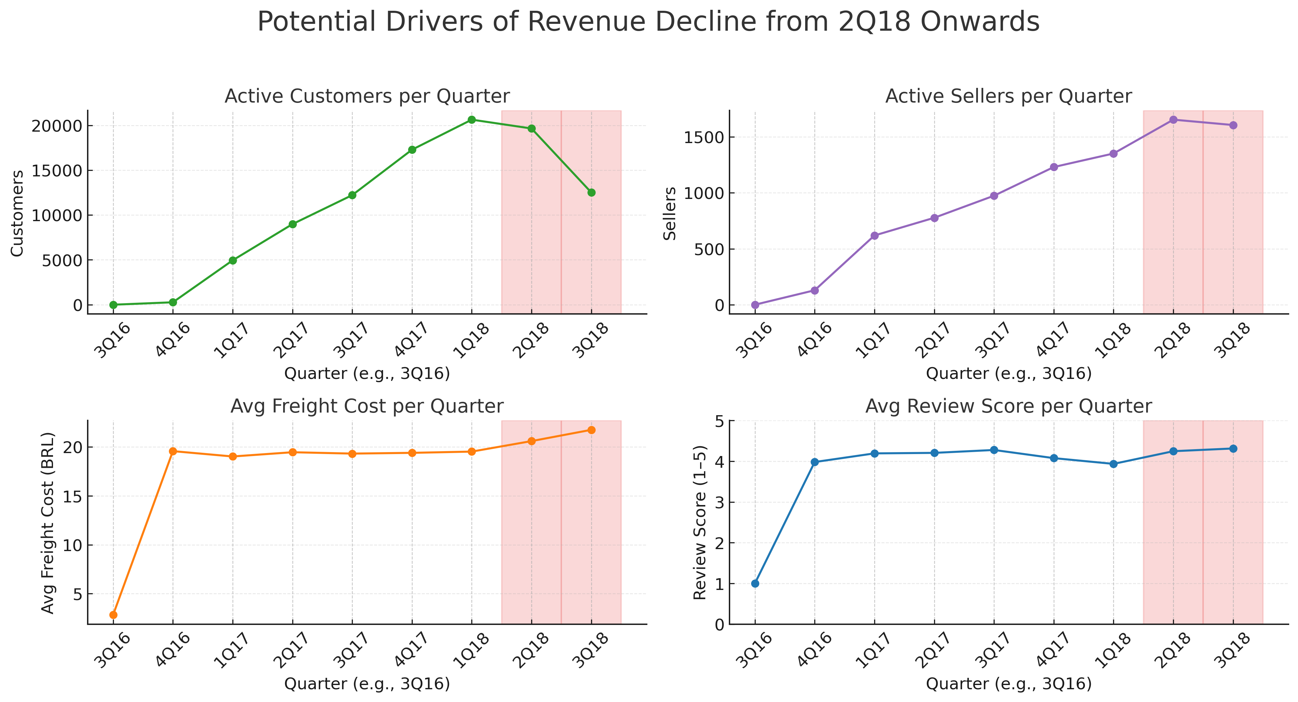
Objective 3: How Have Sales and Orders Changed Over Time?

Slide 27

Objective 4: Develop a model that predicts a more robust estimation of delivery date

Slide 28
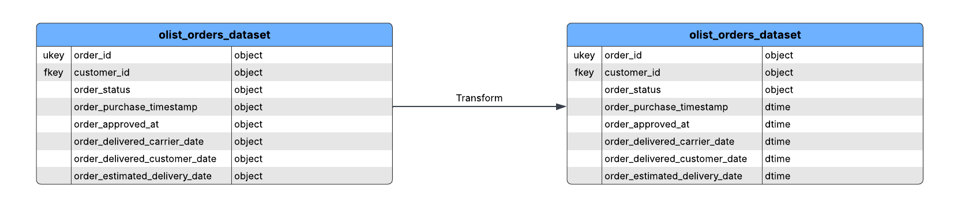
Data Transformation
Converting to date time datatype

Slide 29
Data Transformation
3NF to One Big Table

Slide 30
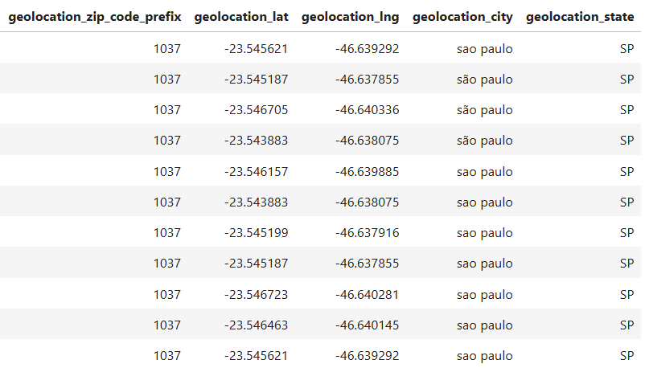
Data Transformation
Aggregating zip code prefix by the longitude and latitude average

Slide 31
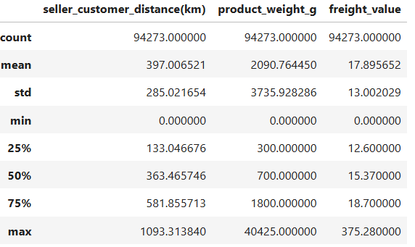
Data Transformation
Standardization of 'seller_customer_distance(km)', 'freight_value', 'product_weight_g'

Slide 32
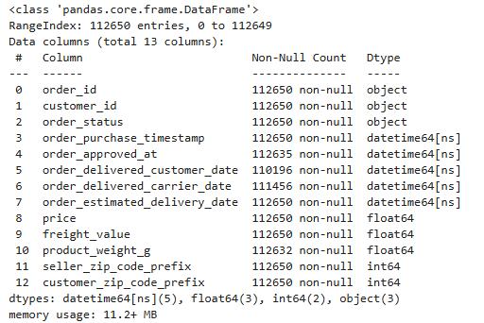
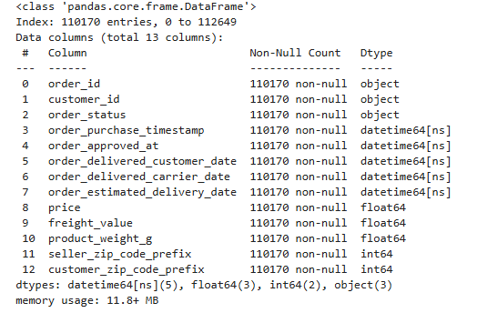
Does Olist Store meet delivery commitments?
Data Cleaning
Raw Dataset
Cleaned Dataset

Slide 33
Data Cleaning
Cleaning Step | What We Did | Why This Was Necessary
Filter data | Only select "delivered" orders in `order_status` column | Since only delivered status has data for when order was received by the customer.
Dropping Null Values | Drop null values on columns `order_delivered_customer_date`, `product_weight_g`, and 'order_delivered_carrier_date' | Because each data differs from so many factors.
Imputation | Fill null values in `order_approved_at` by the median time it takes for an order to get approved | Outliers are present within the data

Slide 34
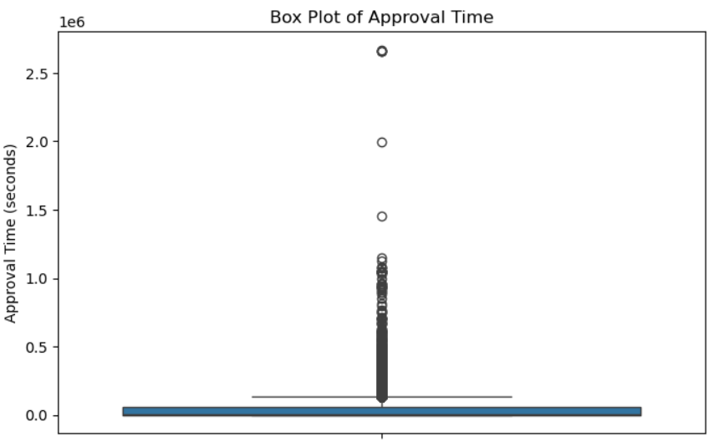
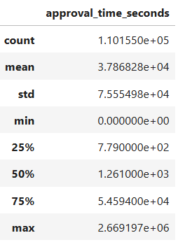
Data Cleaning

Slide 35
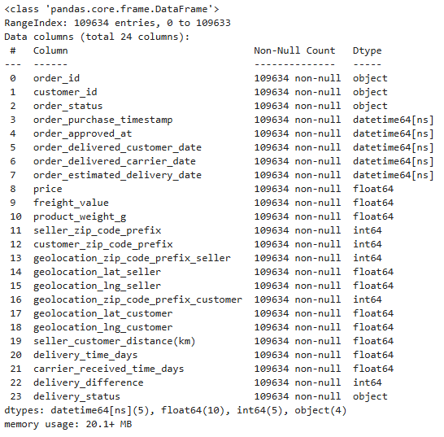
Does Olist Store meet delivery commitments?
Feature Engineering
Before Feature Engineering
After Feature Engineering

Slide 36
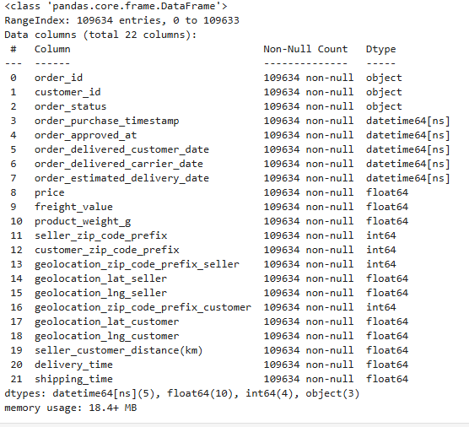
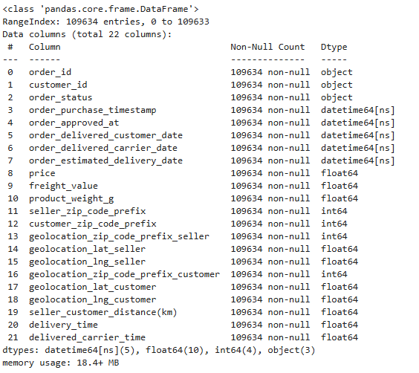
Does Olist Store meet delivery commitments?
Feature Engineering
Get the distance in kilometers of the seller and customer.
`seller_customer_distance(km)` =
( customer longitude and latitude data) & (seller longitude and latitude data)

Slide 37
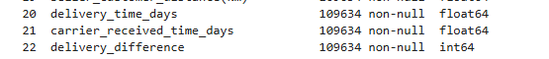
Does Olist Store meet delivery commitments?
Feature Engineering
Calculating the time it took:
to receive the package by the carrier
to deliver the package to customer; and
The difference of the estimated delivery date and delivered date
`delivery_time_days` =
`order_delivered_customer_date` - `order_purchase_timestamp`
`carrier_received_time_days` =
`order_delivered_carrier_date` - `order_approved_at`
`delivery_difference` =
`order_estimated_delivery_date` - `order_delivered_customer_date`

Slide 38
Does Olist Store meet delivery commitments?
Feature Engineering
Identify whether the order was received on time or was delayed.
If delivery difference is positive, then delivery status is "On Time". While delivery difference is negative, then the order was delivered "Delay".

Slide 39
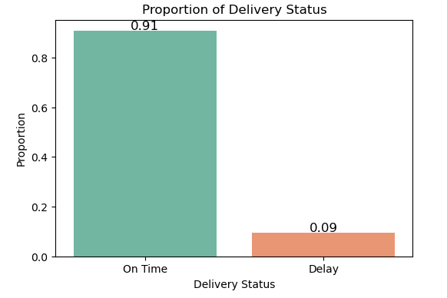
Does Olist Store meet delivery commitments?
Exploratory Data Analysis
On Time: When customer received the order on or before the estimated delivery date
Delay: When customer received the order after the estimated delivery date
Conclusion:
91% of the order was delivered on time.

Slide 40
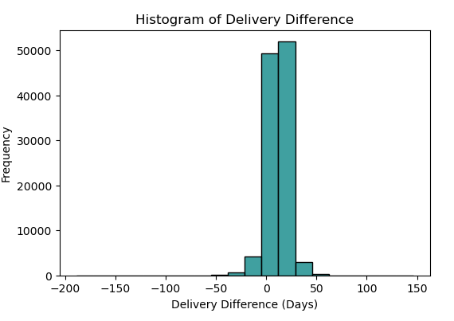
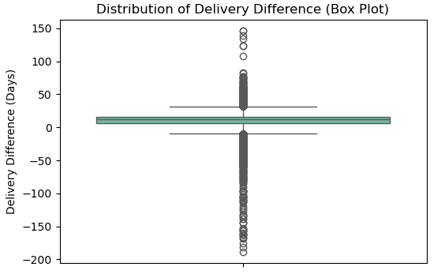
Does Olist Store meet delivery commitments?
Exploratory Data Analysis
Interquratile range (IQR) is somehow small: 10 days difference
Q1 (25th percentile): 6 days difference
Q3 (75th percentile): 16 days difference
Are the remaining data outliers?
Notes:
The box plot shows a high number of outliers in both positive and negative directions.
The interquartile range (IQR) is relatively small, meaning most deliveries are close to the estimated delivery date.

Slide 41
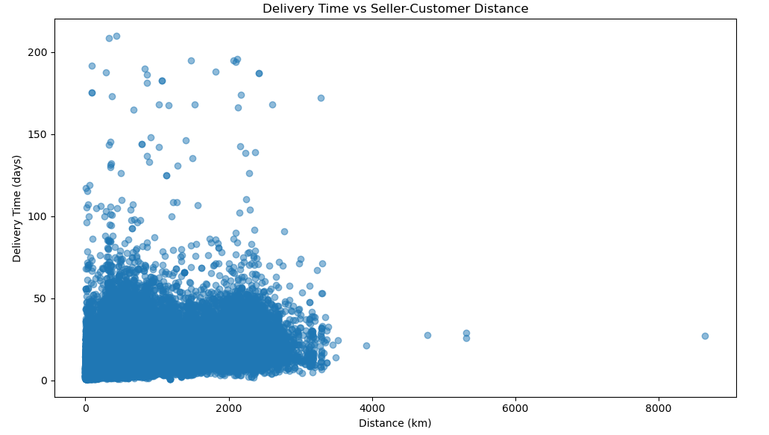
Does Olist Store meet delivery commitments?
Handling Outliers

Slide 42
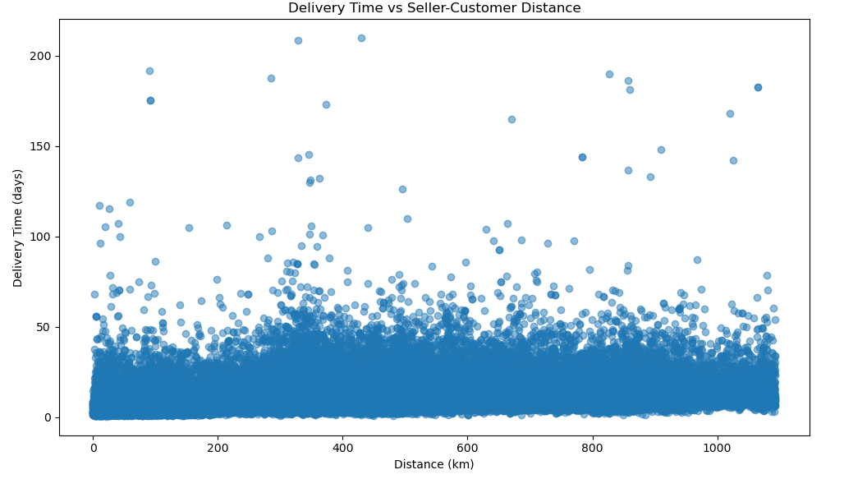
Does Olist Store meet delivery commitments?
Handling Outliers

Slide 43
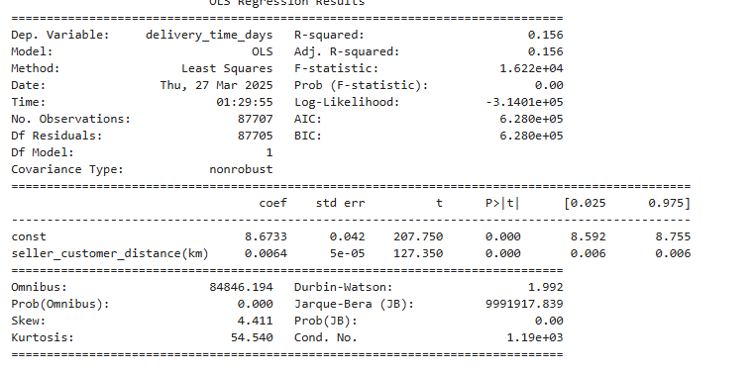
Does Olist Store meet delivery commitments?
Model 1

Slide 44
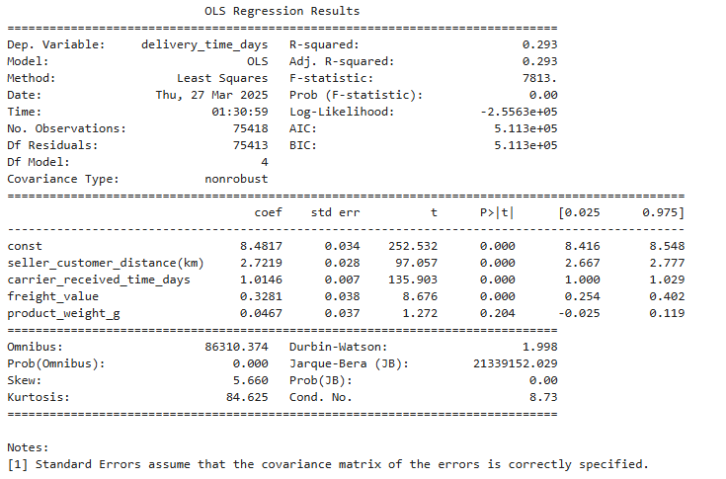
Does Olist Store meet delivery commitments?
Model 2

Slide 45
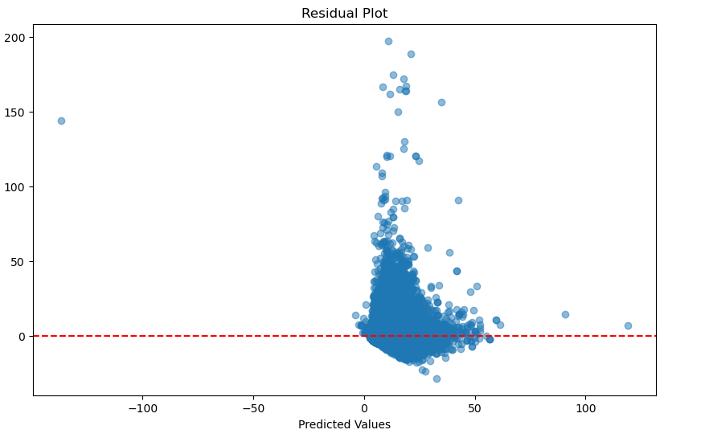
Does Olist Store meet delivery commitments?
Model 2

Slide 46
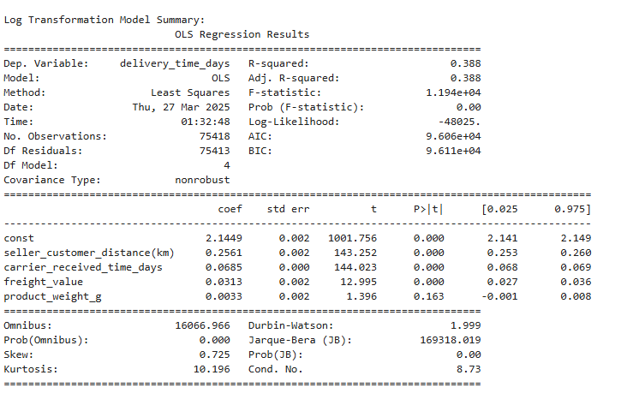
Does Olist Store meet delivery commitments?
Model 3

Slide 47
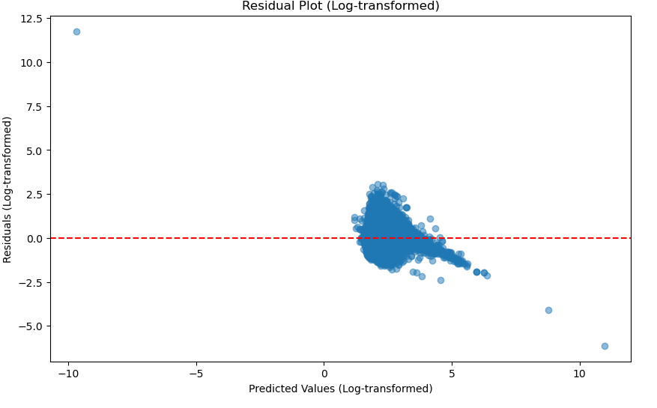
Does Olist Store meet delivery commitments?
Model 4
Notes:
Reco:
Investigate advanced regression techniques

Slide 48
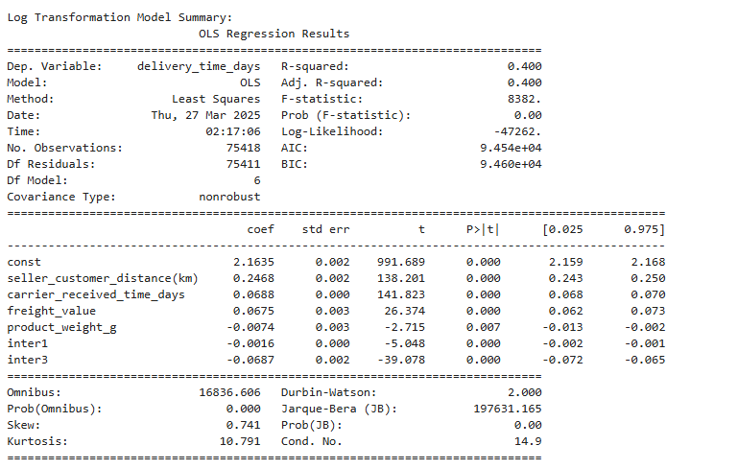
Does Olist Store meet delivery commitments?
Model 4
Interaction terms:
inter1 = product_weight_g * carrier_received_time_days
inter3 = seller_customer_distance(km) * freight_value

Slide 49

What if you have a big dataset,(10,000 times in size) of your current dataset? What database, or what software, or what you will do?

Slide 50
1. Memory limitation: Loading all data into memory (Pandas DataFrame) would be inefficient.
2. Performance issues: Standard processing methods would be slow.
3. Data Integrity: Risk of incomplete processing if memory overloads.
Challenges:

Slide 51
Recommended Tool / Stack | Why?
PostgreSQL/ MySQL (Self-Hosted / Budget-Friendly) | Structured data handling (customer IDs, order IDs, payment details).
Hadoop (Self-Hosted / Budget-Friendly) | Distributed storage for massive datasets (10,000x).
MongoDB + BI Tools (PowerBI, Tableau) | Semi-structured data handling (JSON, reviews).
GCP or AWS S3 + Athena + Pandas (Startup / Prototype) | Cloud solutions for fast prototyping and scalability.
Google BigQuery (Mid-Scale) | Scalable, serverless solutions for analytical workloads.
Amazon Redshift (Enterprise) | High-performance data warehousing with cloud integration.
Apache Spark / Dask (In-Memory Processing) | Fast, distributed computing for large datasets.
Notes:
Since Olist is currently valud at $1.5B – we can assume (based on requirement) the use of Amazon Redshift.

Slide 52

Final Choice: Amazon Redshift
Handling Big Data Efficiently
Distributed & Scalable
Optimized for Complex Queries
Integration with AWS Ecosystem
Cost-Effective
Notes:
Overall, Amazon Redshift meets all our requirements, making it the best choice for our analysis and visualization of customer distribution and sales performance.
Redshift:
Handling big data: massively parallel processing (MPP), advanced compression feature (distributed nodes)
Scalable: Can adjust based on the load by increasing nodes
Smaller 2 node: RA3.xlplus estimate of 1.5k per month
4 node large nodes: RA3.4xlarge estimate of 25k per month. Optimized for complex queries: Advanced Query Optimizer: Redshift’s cost-based optimizer analyzes query plans and selects the most efficient way to execute complex SQL statements. It can push down operations, choose efficient join strategies, and leverage statistics on data distribution to optimize performance. Integration with AWS Ecosystem: AWS S3 (storage) , Sagemaker (Machine Learning), etcc
Cost Effective: On-Demand and Reserved Pricing Options: Redshift offers on-demand pricing for flexibility and reserved instances for long-term commitments, which can provide significant discounts (often 20%–60%) compared to on-demand rates if your workload is predictable.

Slide 53
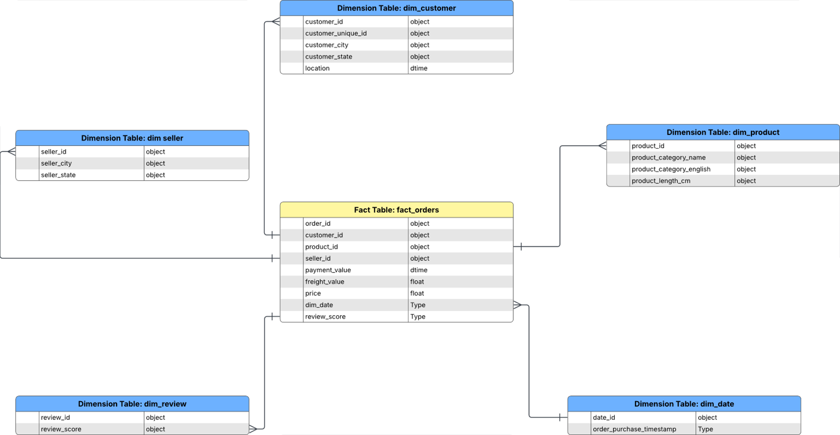
Star Schema
Notes:
A star schema organizes data into a central fact table (holding the bulk of the 1 billion rows) and smaller dimension tables.
This reduces the number of complex joins and simplifies aggregation queries, which is beneficial for high-performance analytical queries. Mech faster especially for low code professionals.
Easier to incorporate when using with BI tools – PowerBI / Tableau, since it’s generally easier to understand, BI professional can make dashboard/ reports faster OBT: Give’s too much redundancy.

Slide 54
ETL
ELT
Notes:
Load the raw data and do as many transformation as needed based on need / requirement
Load data faster and then transformation processing later making it much faster on the use case.
ELT leverages the compute power of your data warehouse, Amazon Redshift offers cost-effective computational resources that scale with your needs Overall, e-commerce business generate big date overtime due to quick and large number of transactions on a day-to-day basis.

